Slide 1
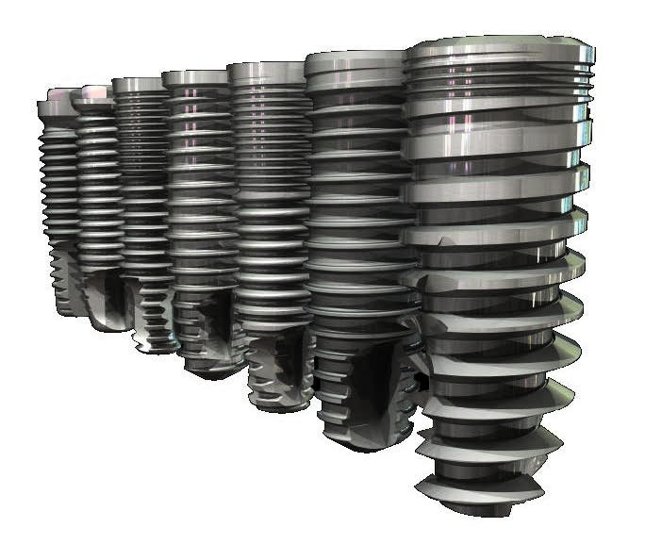
Value added implants
Microelectronics technologies for medical applications

Slide 2
Founding partners
Dr. Alexander А. Ayrapetov is an expert in solid state surface plasma treatment and composite materials synthesis with more tan 40 years experience. He developed plasma discharge technology and equipment for carbon thin films deposition. The technology and equipment enables to obtain thin carbon films with different phase composition. Based on the technology and equipment new reliable process of diamond like nonresorable diamond like carbon (DLC) films deposition was elaborated. The content of diamond phase (Sp3) in the films with thickness 150-200 nm is not less than 95%. The film prevents the implant from erosion and protect human body from uncontrolled penetration of ions.
Mr. Sergei А. Kiselev graduated from Moscow Technical University for Electronics Technology but later became a specialist in biotechnology. He developed a new type of organic coating for dental implants. The coating enhanced ontogeny and in a targeted way influence on regenerative processes in peri-implant tissue. The film as well exhibit bactericidal properties. IP protected with the patent of the Russian Federation.

Slide 3
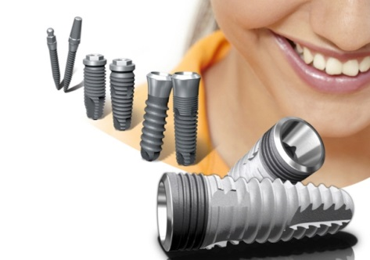
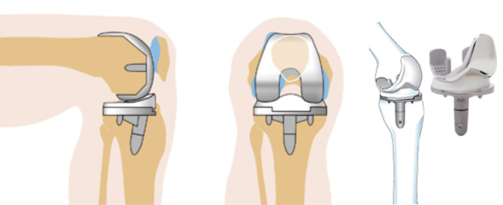
Market size
The global dental implants & prosthetics market in 2015 reached $7,365.7 Million and expected to reach $10,427.7 Million in 2020 and is poised to grow at a CAGR of 7.2% during the forecast period of 2015 to 2020.
Market and Markets

Slide 4
Target Market
At Stage
1. Dental implants
2. Endoprosthesises
3. Valve prosthesis, Intrauterine contraceptives, Haemodialysis machines, Hardiac pacemakers etc.
Main Competitors:
TiUnite - for Nobel Biocare (USA);
NanoTechTM – for AlphaBio (USA- Israel);
SLActive –for Straumann (Swetzerland).
No one of the competitors possess comparable know-haw and the methodology.

Slide 5
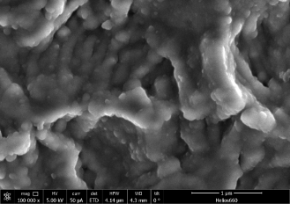
Product
Dental implants and endoprothesies with double layered coatings with NO implant corrosion – no world analogues
implant surface morphology

Slide 6
Time to Market
Product launch will be possible in 2018.
By 2022 10% of dental implants world market will be controlled.
By 2030 the NewCo will be able to control not less than 10% of the world market of different types implants.

Slide 7
Problems to be solved
First coating of titanium implant with diamond like thin film prevents the implant from resorption and protection of human body from implant breakdown products. Resistance to Oppenheimer Effect achieved*.
Second coating enhanced ontogeny and reduce implant failure.
*B.S., Oppenheimer E.T., Danishefski I., Stout A.P: Carcinogenic Effect of Metals in Rodents. Cancer research 1956;16:439-441

Slide 8
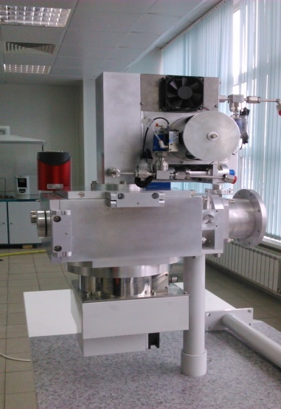
Project current status
Batch of implants with double layered coating produced.
Wear-resistance and diffusion barrier properties of DLC were examined. Regimes and process flow of reliable DLC generating were established. Conceptual design of industrial equipment was developed.
Composition and methods of deposition of the organic coating were developed.
Preclinical studies of implants were partly carried out.
Check studies of new implants including hydrophilism, bactericidal and hemostatic activity as well as sanitary-chemical and toxicity studies were conducted.

Slide 9
Intellectual Property
Мultiparameter method of DLC is the subject of Know-How;
The second organic layer patented in Russian Federation an international patent will be made on demand of project investor.

Slide 10
References
F. Aleksandrova, A. K. Petrova, K. V. Vavilin, E. A. Kralkina, P. A. Neklyudova, A. M. Nikonova, V. B. Pavlov, A. A. Ayrapetov, V. V. Odinokov, V. A. Sologub, and G. Ya. Pavlov. Investigation of the Helicon Discharge Plasma Parameters in a Hybrid RF Plasma System./ APPLIED PHYSICS. – 2015. – No 3/ pp. 25-28.

Slide 11
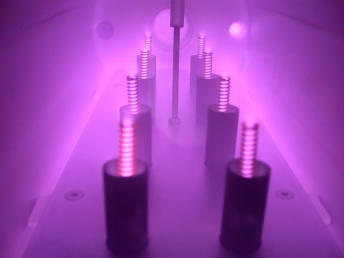
Principal and Financial
US$2.36M needed to build the manufacturing line. This line can be scaled for massive production at any appropriate site.

Slide 12
Market penetration model
Partnership with implants manufacturers and distributors based on exclusivity agreement. Starting from emerging states markets – China, Russia, India etc.

Slide 13
Partners benefit
1. Global Competitiveness
2. Increase of Income
3. Capitalization Growth

Slide 14
Thank you for your Attention
Q&A

